Slide 1







Resolution Proposition
Cira Vlad-Stefan

Slide 2
Exercise 4.2
Build a linear refutation from the following set of clauses:

Slide 3




Exercise 4.2
Build a linear refutation from the following set of clauses:
C1 =
C2 =
C3 =
C4 =

Slide 4




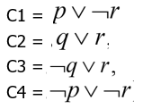
C1: top clause(var1)
C1
C2
C2 is used a side clause for C1
C5 = Res r (C1, C2) =
C6 = Res p (C5, C4) =
C7 = Res q(C6, C3) =
C5
C4
C6
C3
C7 = tautology

Slide 5
C1: top clause(var2)
C1
C2
C2 is used a side clause for C1
C5 = Res r (C1, C2) =
C8 = Res q (C5, C3) =
C9 = Res(C8, C4) =
C5
C3
C8
C4
C9 =tautology

Slide 6
C1: top clause(var3)
C1
C3
C3 is used a side clause for C1
C10 = Resp,q (C1, C3) =
C11 = Resp,r (C10, C2) = = C7
C12 = Resp,r(C11, C4) = Resp,r(C8, C4)
=
C10
C2
C11
C4
C12 =

Slide 7

C1: top clause(var4)
C1
C3
C3 is used a side clause for C1
C10 = Resp,q (C1, C3) =
C13 = Resq,r (C10, C4) =
C14 = Resq,r(C13, C2)
C10
C4
C13
C2
C14 =

Slide 8
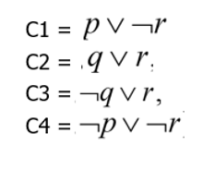
C1
C4
C5
C2
C5 = Res(C1,C4) = ⌐r
C6
C3
C6 = Res(C5, C2) = q
C7 = Res(C6, C3) = r
C8 = Res(C7, C5) =
C7
C5
C8 =

Slide 9
C1
C4
C5
C3
C5 = Res(C1,C4) = ⌐r
C9
C2
C9 = Res(C5, C3) = ⌐q
C10 = Res(C9, C2) = r
C8 = Res(C7, C5) =
C7
C5
C8 =

